Slide 1
Edmodo
An Online Social Learning Network

Slide 4
Edmodo is just like the classroom, but online. Students will follow the expectations set out, or they will no longer have the privilege of using Edmodo.
We will treat each other on Edmodo in the same manner we do in class. Students will participate in the online discussions (staying on topic) while being polite and respectful to one another.

Slide 5
Edmodo is just like the classroom, but online. Students will follow the expectations set out, or they will no longer have the privilege of using Edmodo.
Edmodo allows students to post to the whole group or to the teacher, and all posts are visible to the teacher. If students are not following the guidelines, they will be put on Read-Only status or removed from the group.

Slide 6
Edmodo is just like the classroom, but online. Students will follow the expectations set out, or they will no longer have the privilege of using Edmodo.
Students will be required to use appropriate grammar instead of texting language.

Slide 7
Safety
We are using first names only.
This is a closed group. Not just anyone can join.
We will not upload pictures. We will use the Edmodo avatars.
We will not share identifying information like…
Our last names
Our addresses or telephone numbers

Slide 8
Citizenship
We will support our classmates and encourage each other.

Slide 9
Ownership
Write in complete thoughts and sentences.
Just like in writing celebrations, write more than, “Cool” or “Awesome.” What exactly is cool or awesome?
Stay on topic. We will have fun discussing school-related topics. We are not talking about personal issues or events.

Slide 10
Respect
We will talk to each other online with respect.
No put-downs or negative comments. Think, “Would my teacher let me say this during a lesson?”
Use appropriate language. If you’re not sure if a word or joke is okay, then it’s not.
All of us are trying to learn and do our best.

Slide 11
Etiquette
DO NOT PUT SENTENCES IN ALL CAPITAL LETTERS. Do you know why?
No txting lingo. We r @ school…show me what u know!
No symbols or smiley faces, ☺K?!
Use a capital letter at the beginning of your sentences.
Use punctuation at the end of your sentences.

Slide 12
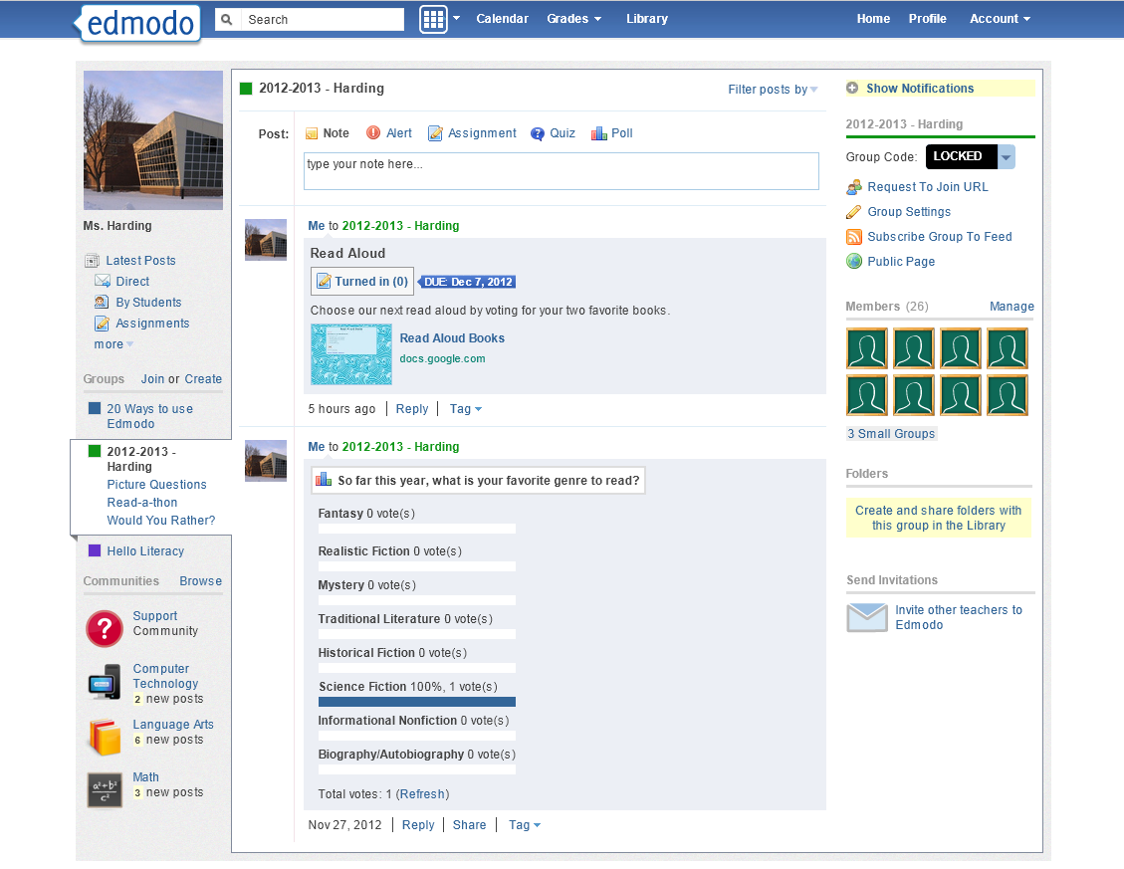

Slide 13
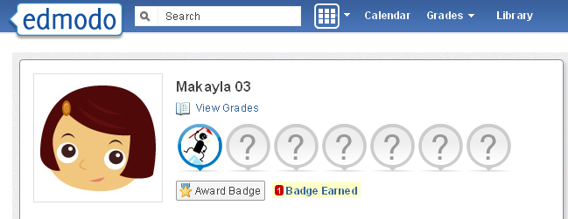
Badges
Badges can be earned for many things.

Slide 14
Edmodo!
I can’t wait to…

Slide 15
To Do List
Login - Use your AR password (long number, short number)
Click Account Settings - Change your avatar
(Click Home) Poll – vote for your favorite genre
Log out

